Slide 1
MCQC
Monadic Coq Compiler
Lef Ioannidis <elefthei@mit.edu>

Slide 2
Motivation
Make formally verified code fast and portable

Slide 3
Existing approaches

Slide 4
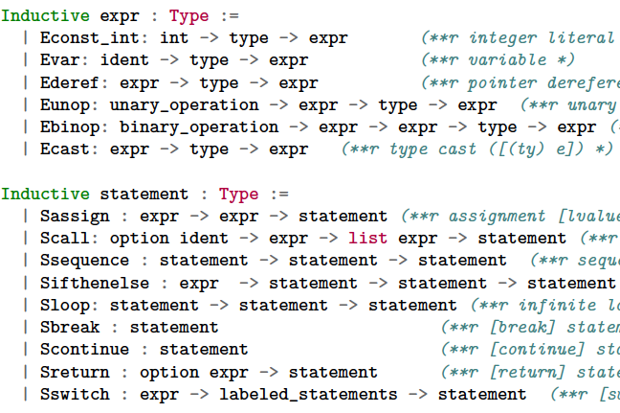
Deep Embeddings
C-light
CompCert [Ler+12]
Kami [Joo+17]
Cryptol [Our+08]
OEuf [Mul+18]
. . .
+ operational semantics
+ verified compilation
ASM
Notes:
Show in contrib

Slide 5
Shallow Embeddings
Haskell Extraction
FSCQ [Che+15]
Jitk [Wan+14]
. . .
coqc
{
Large RTS
Slow performance
Large TCB
Not portable
ghc
.exe
Notes:
Give hello world example,

Slide 6
MCQC Pipeline
C++17 Extraction
coqc
JSON
{
No RTS
Fast performance
Smaller TCB
Portable output
mcqc
base,
syscall
clang
.exe

Slide 7
Why C++17
Lambdas (C++11)
Sum Types (C++17)
“Weakly Typed”
Parametric polymorphic
Smart pointers (C++11)
Goal is to compile verified:
Linux modules
Arduino code
Interpreters/JITs
Garbage collectors
Smart contracts
. . .

Slide 8
Arithmetic

Slide 9
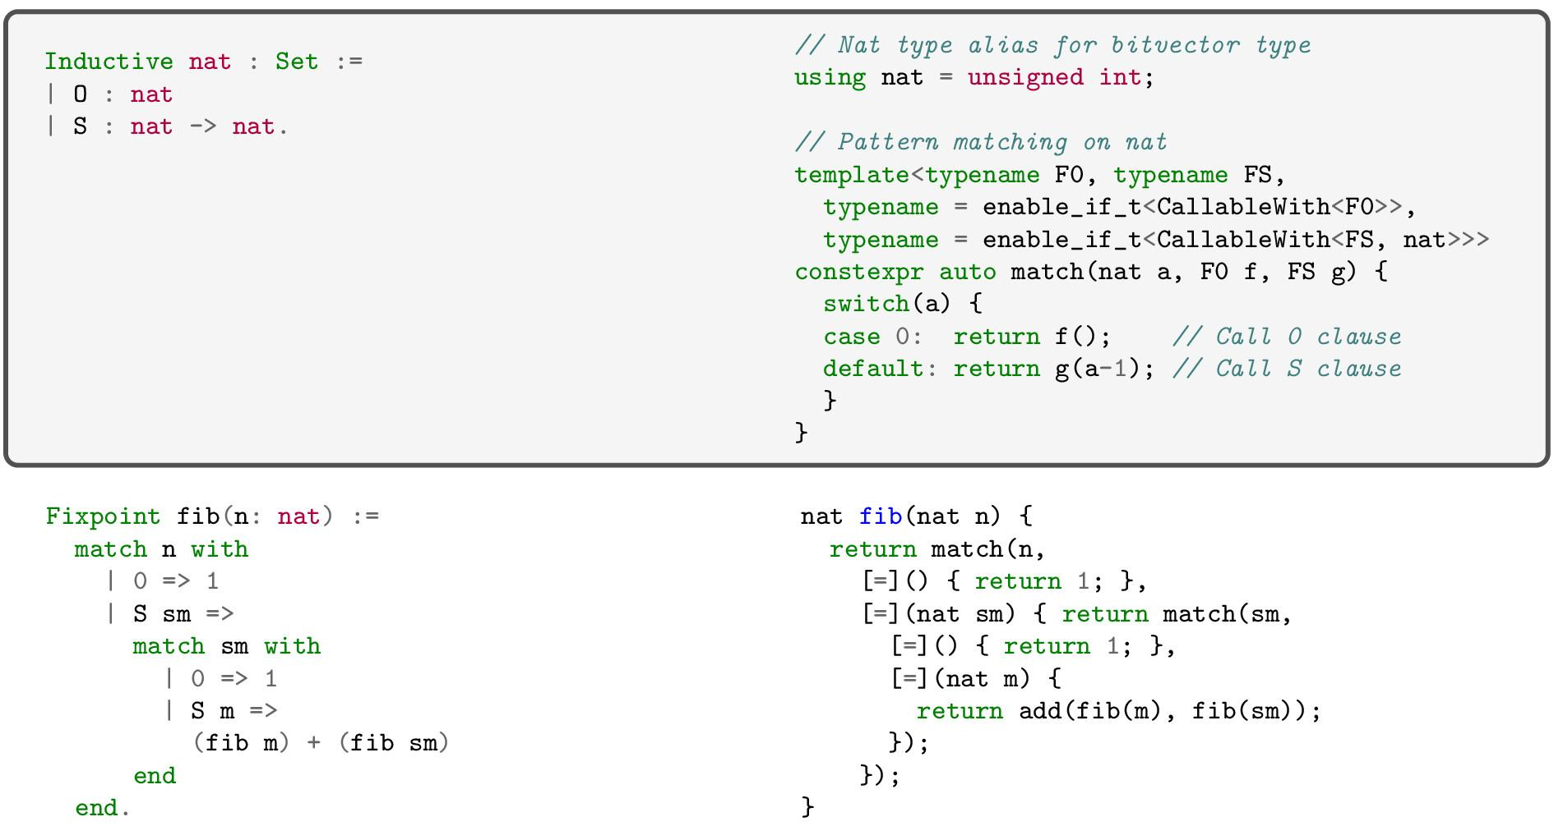
C++17
Lib

Slide 10
Polymorphic ADTs

Slide 11
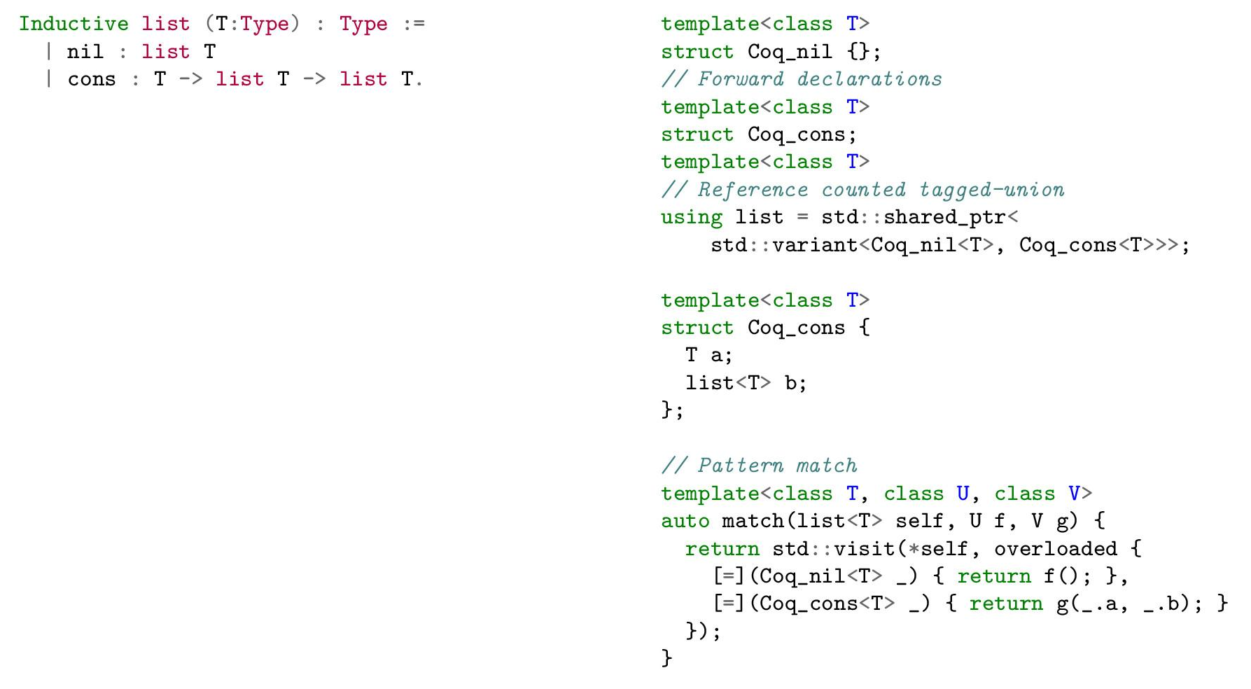
C++17
Reference-counted, tagged union
Higher-order, polymorphic pattern matching

Slide 12
Higher-order logic

Slide 13
C++17
Notes:
Sections are expanded by Coq extraction. Fundep needed to constraint too general type for F.

Slide 14
IO Monad

Slide 15
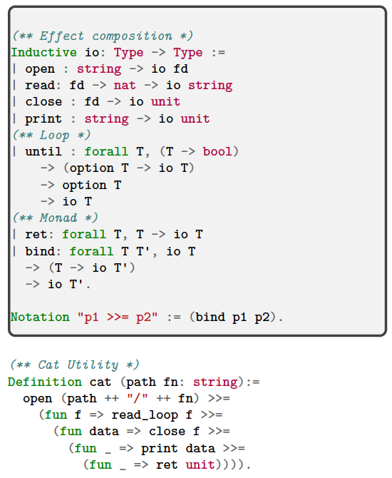
Lib
C++17

Slide 16
Implementation
1800 lines of Haskell
200 lines
of Coq
600 lines
of C++17
+
+
MCQC
typeclasses
library

Slide 17
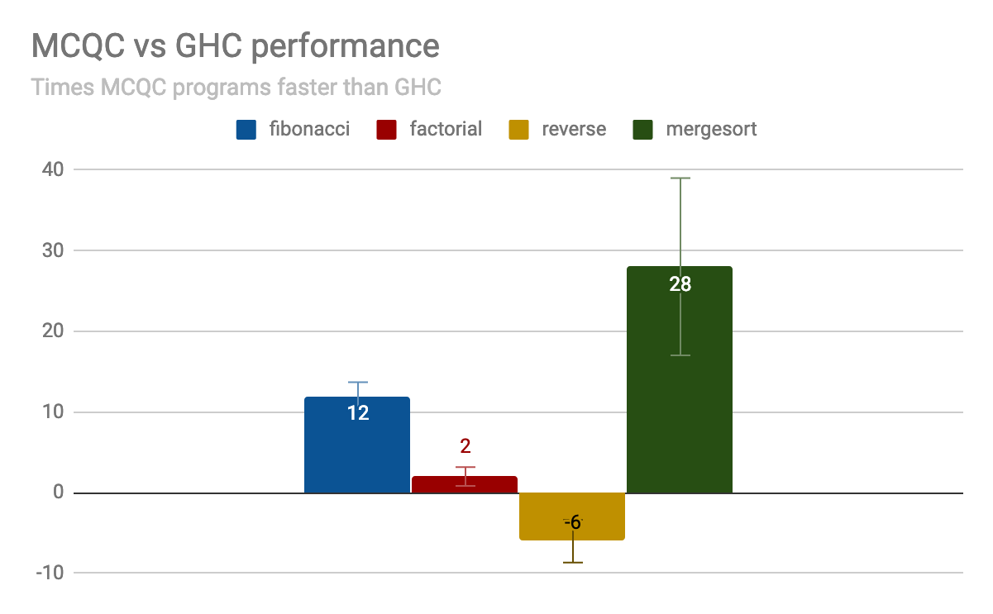
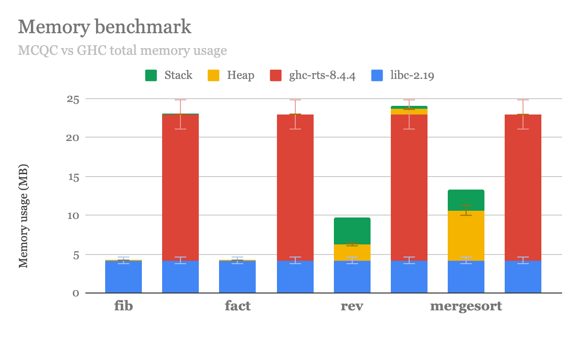
Benchmarks
MacOS 10.14 Mojave, Macbook Air 1.4 GHz, Intel Core i5, 4GB DDR3
Using time, valgrind --tool=massif, ghc-prof-8.4.4

Slide 18
Try MCQC
https://github.com/mit-pdos/mcqc

Slide 19
References
[Ler+12] Leroy, Xavier. "The CompCert verified compiler." Documentation and user’s manual. INRIA Paris-Rocquencourt 53 (2012).
[Cho+17] Choi, Joonwon, et al. "Kami: a platform for high-level parametric hardware specification and its modular verification." Proceedings of the ACM on Programming Languages 1.ICFP (2017): 24.
[Our+08] Oury, Nicolas, and Wouter Swierstra. "The power of Pi." ICFP. Vol. 8. 2008.
[Let08] Letouzey, Pierre. "Extraction in coq: An overview." Conference on Computability in Europe. Springer, Berlin, Heidelberg, 2008.
[SPJ+93] Jones, SL Peyton, et al. "The Glasgow Haskell compiler: a technical overview." Proc. UK Joint Framework for Information Technology (JFIT) Technical Conference. Vol. 93. 1993.
[Ana+17] Anand, Abhishek, et al. "CertiCoq: A verified compiler for Coq." The Third International Workshop on Coq for Programming Languages (CoqPL). 2017.
[Mul+18] Mullen, Eric, et al. "Œuf: minimizing the Coq extraction TCB." Proceedings of the 7th ACM SIGPLAN International Conference on Certified Programs and Proofs. ACM, 2018.
[Jos03] Josuttis, Nicolai M. C++ Templates: The Complete Guide. Addison-Wesley Professional, 2003.
[Che+15] Chen, Haogang, et al. "Using Crash Hoare logic for certifying the FSCQ file system." Proceedings of the 25th Symposium on Operating Systems Principles. ACM, 2015.
[Wan+14] Wang, Xi, et al. "Jitk: A trustworthy in-kernel interpreter infrastructure." 11th USENIX Symposium on Operating Systems Design and Implementation (OSDI). 2014.

