Slide 1
A Sybil-proof DHT using a social network
Socialnets workshop
April 1, 2008
Chris Lesniewski-Laas
MIT CSAIL

Slide 2
Overview
Distributed Hash Tables
The Sybil attack
Model (network, adversary)
Tool: random sampling from a social network
Sybil-proof DHT protocols

Slide 3
DHT routing in three slides
2¹⁶⁰
0
Structured DHT: a layer in many P2P systems
Used by requesting node to find another node by ID
IDs typically hash of public key: self-certifying
DHT maps ID to IP address
ID = SHA-1(public key)

Slide 4
DHT routing in three slides
Sub-linear table size
Nodes need not keep track of all other nodes
Reduces bandwidth usage
Enables scaling

Slide 5
DHT routing in three slides
Routing via intermediate hops
Result is authenticated
Trade off table size versus routing hops
s
t
{IP addr}_{PKt}
{ID_{t}}
{ID_{t}}
{ID_{t}}

Slide 6
The Sybil Attack
“One can have, some claim, as many electronic personas as one has time and energy to create.”
Judith S. Donath

Slide 7
DHTs are subject to the Sybil attack
Attacker creates many pseudonyms
Disrupts routing or stabilization
Douceur, 2002: “without a logically centralized authority, Sybil attacks are always possible”
s
t
{ID_{t}}

Slide 8
Methods to limit the Sybil attack
Limit IDs per IP address
Central CA issues IDs
Strong PKI
CAPTCHA
Cryptographic puzzles
All methods have drawbacks
cost, compatibility, barriers to entry
Adversary may have more resources

Slide 9
Social network can help
Nodes have social links to other nodes
social links established outside of the DHT
provides additional information usable by DHT
Chris
Frans
Bryan
Andy
Robert
Sean
Jacob
Paul
Larry

Slide 10
Social network model

Slide 11
Social network model
n = number of honest nodes
for this talk only, all nodes have ~same degree
g = number of attack edges
g = o(n/log n) tolerable by protocol
Correctness is independent of number of Sybil nodes!
Honest region
Sybil region
…
Attack edges

Slide 12
Mixing time
Random walk: choose each hop randomly
Mixing time: #hops until uniform probability
Fast mixing network: mixing time = O(log n)

Slide 13
Sampling by random walks
A random walk has o(1) chance of escaping*
True when g bounded by o(n/log n)
Of r walks, (1-o(1))r = Ω(r) end nodes are good!
Can’t distinguish good from bad nodes in set
Honest region
Sybil region
non-escaping path
escaping
paths

Slide 14
Basic one-hop DHT design
Construct finger table by r random walks
Route to t by asking all fingers about t
If r = Ω(√n log n), some finger knows t WHP
Adversary cannot interfere with routing
s
{t’s IP address}
{know t?}
{know t?}
{t?}
{t?}
{t?}
{t?}
{t?}
r
{forwarded message from s}
t
r
Notes:
Some of the second level fingers should be evil too
“T” message

Slide 15
Properties of this solution
Finger table size: r = O( )
Bandwidth to construct: O(r log n) bits
Bandwidth to query: O(r) messages
Probability of failure: 1/poly(n)
Notes:
In real protocol, n->m
Construction bandwidth uses fewer messages

Slide 16
Preliminary results
Input graph: Orkut scrape
7335 nodes
56211 edges
walk length 10
table size r = 1000
g ~ m
n/log n ≈ 750
2.64%
2.47%
Notes:
talk about experiment setup and axes and meaning
g -> fraction*n/logn
draw arrow at 750
2 horizontal lines: without attack edge and with 750
zoom in
vary r
put dots on points

Slide 17
Properties of this solution
Finger table size: r = O( )
Bandwidth to construct: O(r log n) bits
Bandwidth to query: O(r) messages
Probability of failure: 1/poly(n)
Notes:
In real protocol, n->m
Construction bandwidth uses fewer messages

Slide 18
Structured one-hop DHT
2¹⁶⁰
0
Goal: reduce bandwidth used by routing lookup
Method: add Chord-like structure to DHT
Assign hash IDs on ring
ID=SHA1(PK)

Slide 19
Structured one-hop DHT
Goal: reduce bandwidth used by routing lookup
Method: add Chord-like structure to DHT
Assign hash IDs on ring
Already have finger tables
Need successor tables

Slide 20
Constructing successor tables
Construct finger tables
Sort finger table by ID
Tell each finger about its successors in your finger table
costs extra messages
send O(log n) successors
Each node learns its r successors WHP

Slide 21
Using successor tables
To route, query closest finger to target
finger’s successor table should contain target
If failed, finger may be evil or simply unlucky
Try next closest finger
Expect O(1) tries
s
t

Slide 22
Hard to extend to O(log n) hops
Would like to have smaller routing tables
this requires more hops per lookup
First finger table (from random walks) has o(1) fraction of bad fingers
Successive refinements (closer successors in ID space) using Chord stabilization: fraction of bad nodes grows at each step
Tricky? Yes. Impossible? Unclear.

Slide 23
Summary
DHTs are subject to the Sybil attack
Social networks provide useful information
Created a Sybil-resistant one-hop DHT
Resistant to g = o(n/log n) attack edges
Table sizes and routing BW O(√n log n)
Uses O(1) messages to route
This is important: enables fully decentralized and secure peer-to-peer systems

Slide 24
The “Tom” attack
Tom has 230357403 friends.

Slide 25
The “Tom” attack
From: Flickr Mail <mail@flickr.com>
Subject: [Flickr] You are aameesh's newest contact!
Date: 29 Mar 2008 08:00:19 +0000
To: ctl-flickr@mit.edu
Hi Chris Lesniewski,
You are aameesh's newest contact! If you don't know aameesh, aameesh is probably a fan of your photos or wants a bookmark so they can find you again. There is no obligation for you to reciprocate, unless you want to. :)

Slide 26
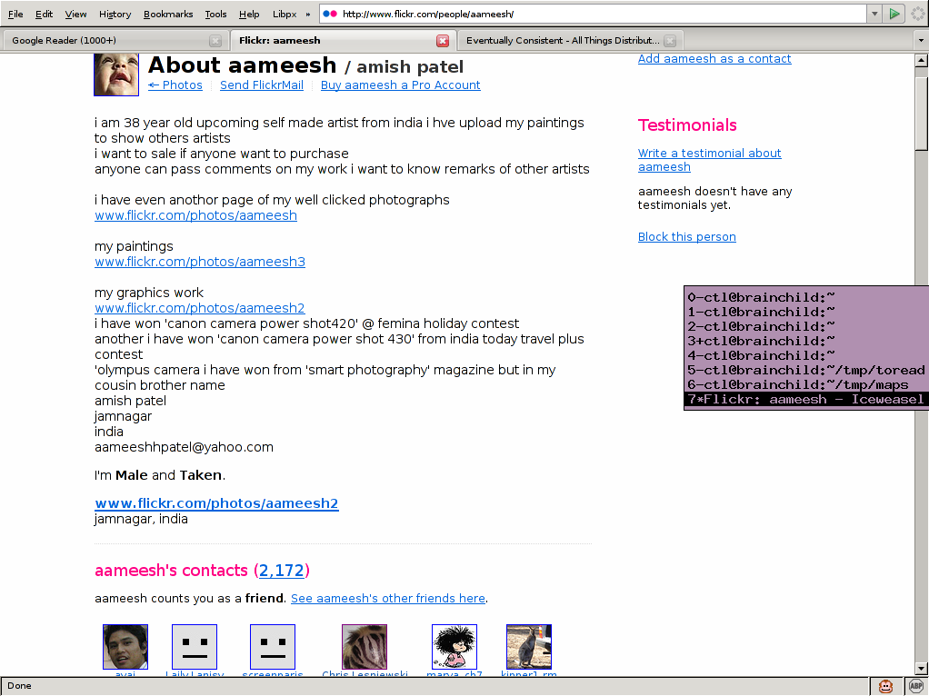
The “Tom” attack
From: Flickr Mail <mail@flickr.com>
Subject: [Flickr] You are aameesh's newest contact!
Date: 29 Mar 2008 08:00:19 +0000
To: ctl-flickr@mit.edu
Hi Chris Lesniewski,
You are aameesh's newest contact! If you don't know aameesh, aameesh is probably a fan of your photos or wants a bookmark so they can find you again. There is no obligation for you to reciprocate, unless you want to. :)

Slide 27
SybilGuard/SybilLimit [2006/2008 Yu, Gibbons, Kaminsky, Xiao]
Not a DHT, but a “general” Sybil defense
Provides a Sybil/not-Sybil test
Honest node accepts at most O(g log n) Sybils
Wonderful insight: “fast mixing” social networks
Generality comes with a price:
O(√n) bandwidth per test (one suspect, one verifier)
To get at least one good node, need to test Ω(n)!
remember that we must tolerate g = o(n/log n)

Slide 28
Attack on the ID space
IDs come from a hash function (on IP, PK, etc)
Adversary can create many IDs offline
can target a particular range of ID space
Result: “eclipse” attack on a particular node ID
s
t

Slide 29
Balancing protocol
Give each node O(log n) virtual IDs
Increases BW and table size by O(log n)
In finger tables, prune IDs in too-dense ranges
When choosing IDs to prune, always keep the finger with fewer virtual IDs left
result: evenly spaced fingers

Slide 30
Why balancing protocol works
Doesn’t hurt good guys
Extremely unlikely to have very dense ranges
Weeds out spuriously dense IDs from bad guys
Finger tables pruned until balanced
Good guys keep at least one virtual ID
A node with only one virtual ID left always wins
Difficult for adversary to construct ID which collides on all virtual IDs

Slide 31
DHT routing in one slide
5,2
key: (3,5)
Structured DHT: a layer in many P2P systems
Used by requesting node to find a replica node responsible for a key
Sublinear table size
Nodes need not keep track of all other nodes
Reduces bandwidth usage
Enables scaling
Trade off table size versus routing hops
3,2
1,1
√N
3,5

Slide 32
DHTs are subject to the Sybil attack
Attacker creates many pseudonyms
Disrupts routing or stabilization
Methods to limit attack
Limit IDs per IP address
Central CA issues IDs
Strong PKI? CAPTCHA?
all methods have drawbacks

Slide 33
Social network can help
Nodes have social links to other nodes
social links established outside of the DHT
at least one link/node needed to bootstrap DHT
If there is no path s⇝t in the social network, then no DHT protocol can find t from s
Chris
Frans
Bryan
Andy
Robert
S
Sean
S
Jacob
T
Paul
Larry

